Slide 1
1 - Static for the structures
OBJECTIVES:
• Characterization of the links,
• Define the nature of the system,
* Isostatic
* Hyperstatic
• Computation of the efforts introduced by the links
Static - Energetic - CAUC- 2011

Slide 2
Static for structure
A mechanical system is a set of pieces connected by links. To study this system it is necessary to do the modeling of it. This modeling can be accomplished in several ways.
The parts of the system can be considered as :
• Rigid
• Deformable
The links can be modeled :
• with gap or without gap
• with or without energy dissipation.
Static - Energetic - CAUC- 2011

Slide 3
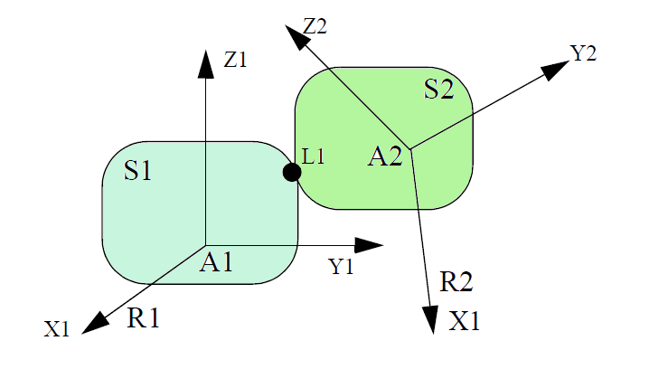
Static for structure
Questions :
What is the load introduced by S1 on S2
What is the displacement of S1 according to S2
Static - Energetic - CAUC- 2011

Slide 4
Displacement / Degree of Freedom
Load introduced by S1 on S2
Rx
Ry
Rz
Mx
My
Mz
Displacement allowed of S1 relative to S2
Tx
Ty
Tz
Rx
Ry
Rz
DEFINITION : The number of degree of freedom of two solids linked together, is the number of elementary displacement that the first solid is allowed to own relatively to the second solid. . It will be noted Nc.
Static - Energetic - CAUC- 2011

Slide 5
Static for structure
This parameter (DOF) can usually be obtained relatively easily by analyzing the physical link. If the movements of S1 from S2 are small, which is usually the case in problems of structural mechanics, we note δTX, δTY, δTZ the components of the translation vector and δθX, δθY, δθZ the components of the vector rotation.
We can then bring up the small displacements torsor {Dd}
Static - Energetic - CAUC- 2011

Slide 6
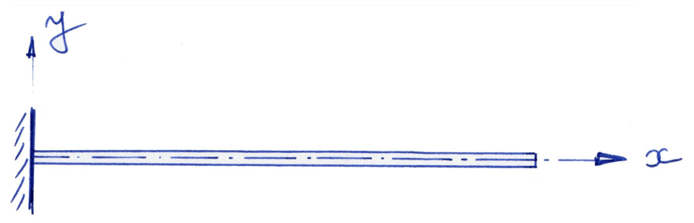
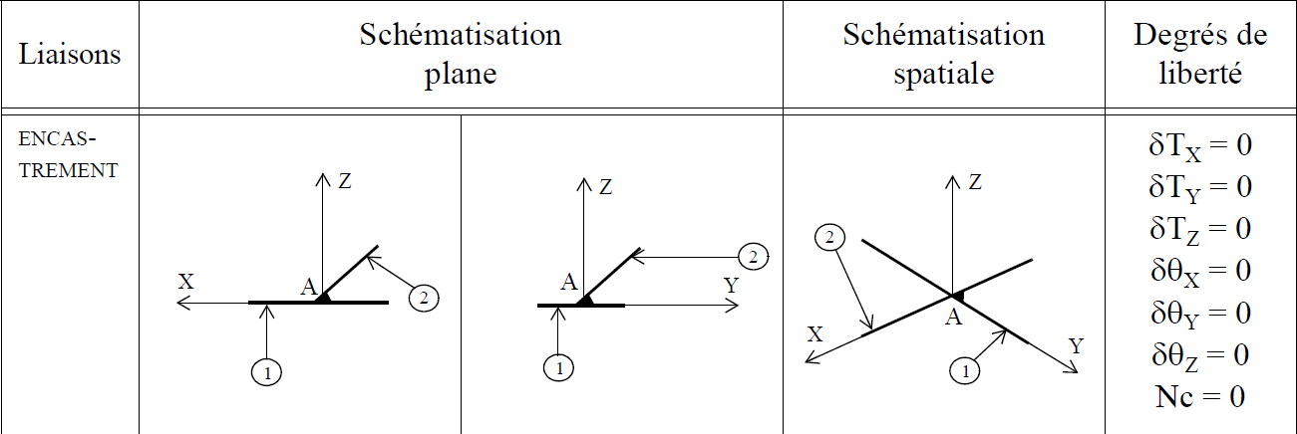
Link
Cantilever
Static - Energetic - CAUC- 2011

Slide 7
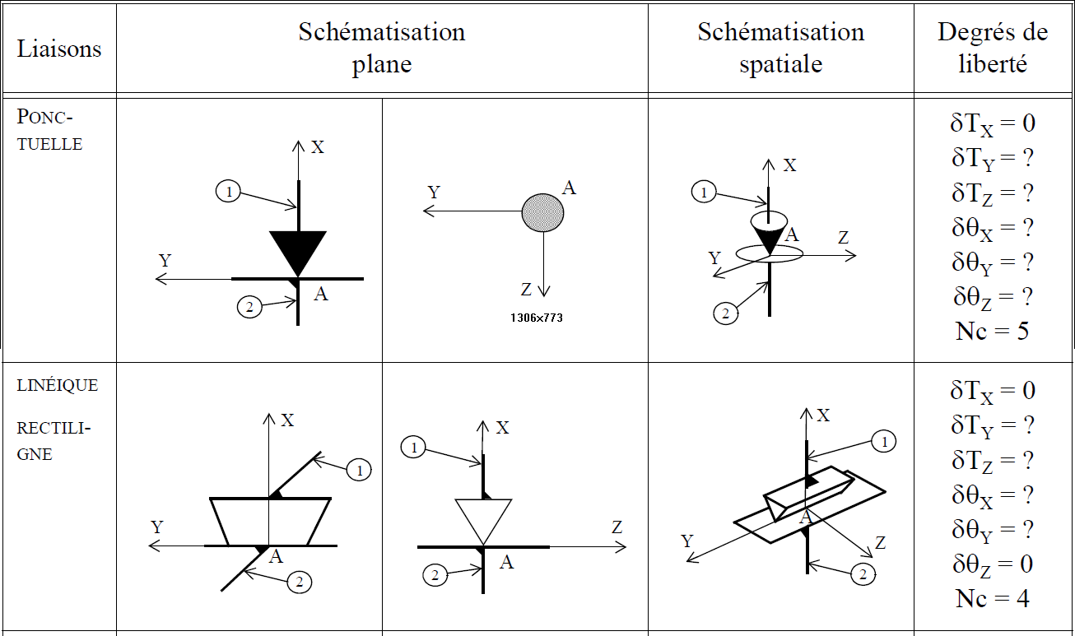
Link
Static - Energetic - CAUC- 2011

Slide 8
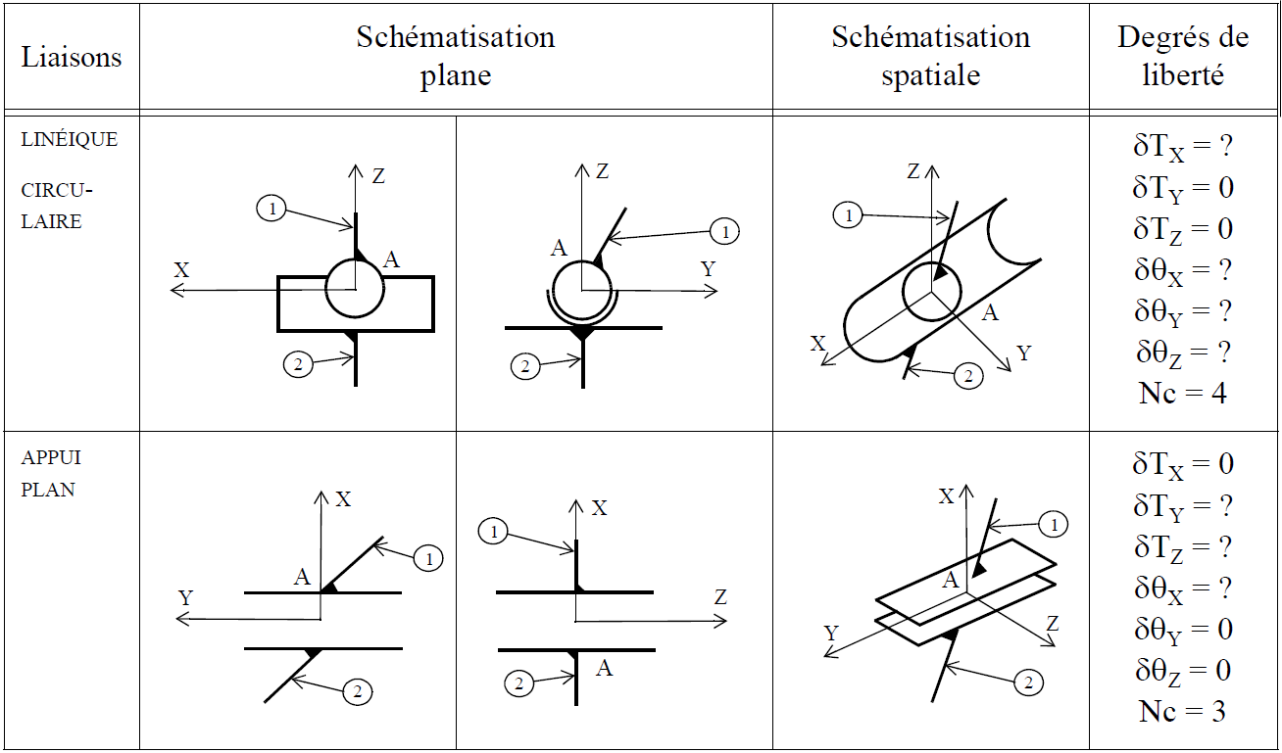
Link
Static - Energetic - CAUC- 2011

Slide 9
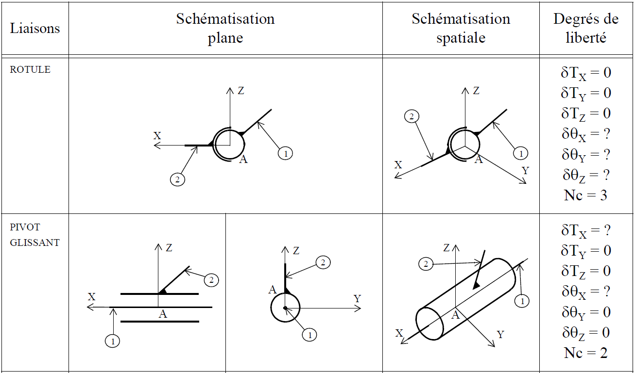
Link : Ball and Sliping Pivot
Static - Energetic - CAUC- 2011

Slide 10
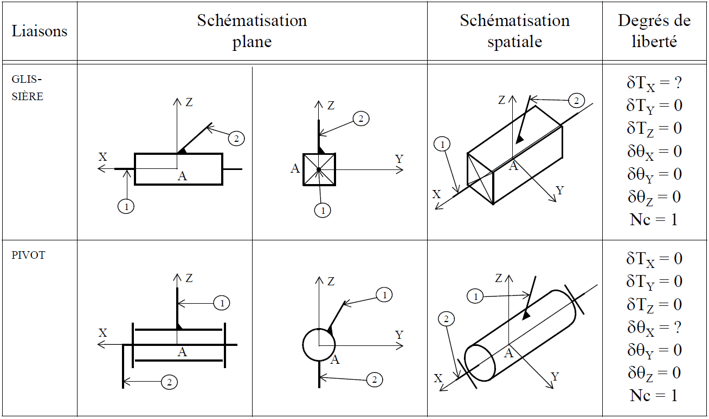
Link : Slide bar and Pivot
Static - Energetic - CAUC- 2011

Slide 11
LOAD
What happens in a link in terms of load is generally complicated to analyse. But it’s easy to speak about the resultant of the forces ans of the moment.
Resultant
Rx
Ry
Rz
Moment
Mx
My
Mz
DEFINITION : The number of independent terms, non equal to zero, of the torsor of the mechanical actions is the number of degree of linkage. It will be noted Ns.
Static - Energetic - CAUC- 2011

Slide 12
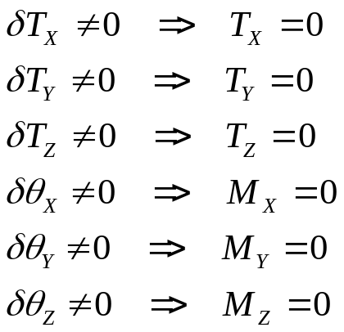
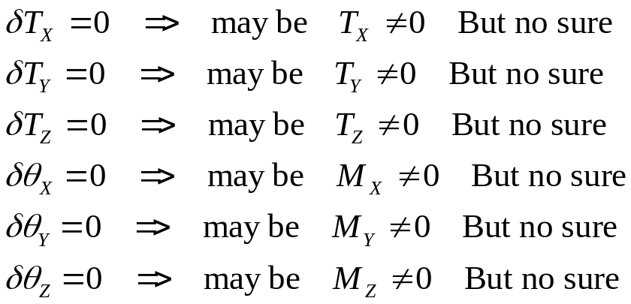
Degree of Linkage
If the link is a perfect link we can write that there is no energy spent for all the displacements allowed by the join
Static - Energetic - CAUC- 2011

Slide 13
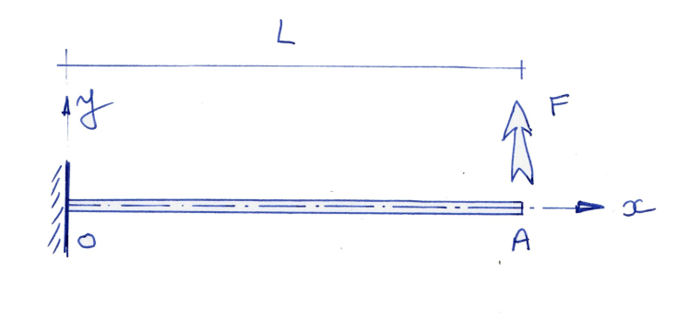
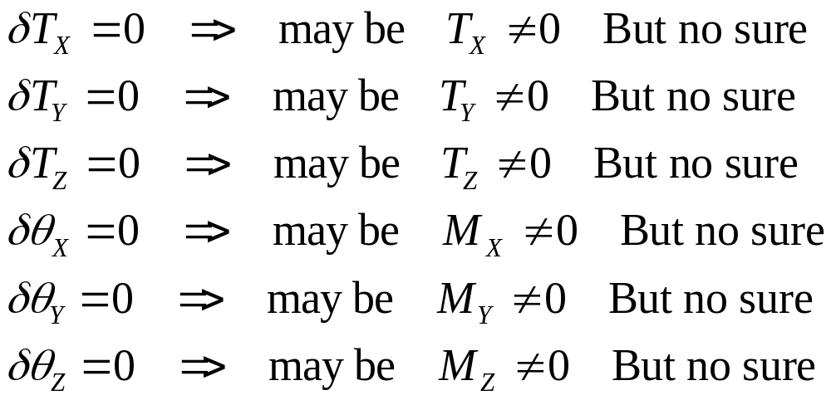
Exemple
Static - Energetic - CAUC- 2011

Slide 14
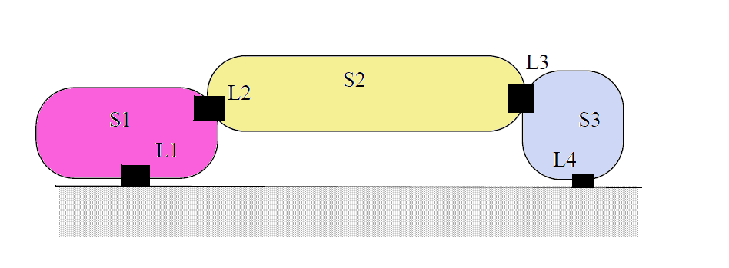
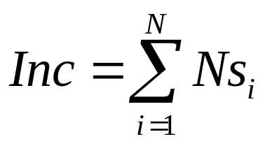
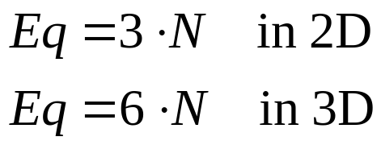
Nature of a system
N solids
Nci DOF
Nsi Reaction
Static - Energetic - CAUC- 2011

Slide 15


Nature of a system : Isostatic
If it’s possible to find the whole unknown reactions just by writing the equilibrium of the system
Static - Energetic - CAUC- 2011

Slide 16
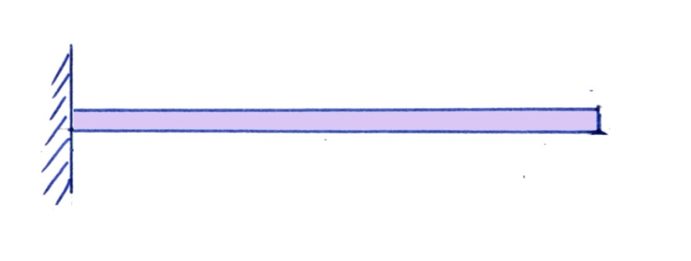

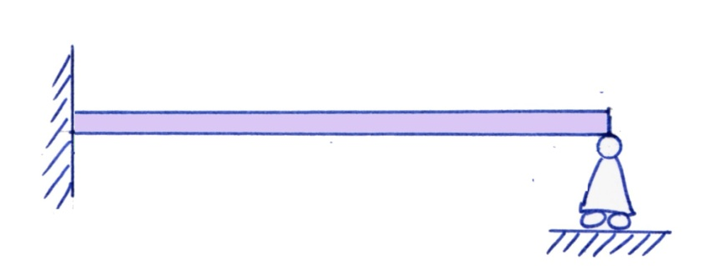

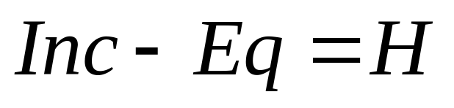
Nature of a system : Hyperstatic
What happend if I add a join ?
Static - Energetic - CAUC- 2011

Slide 17
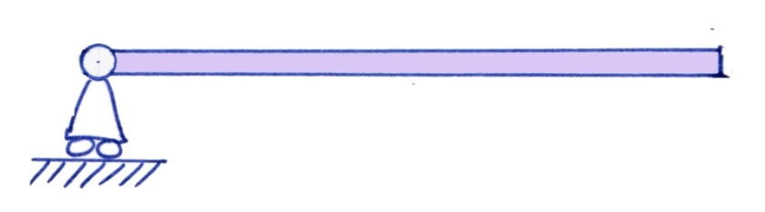

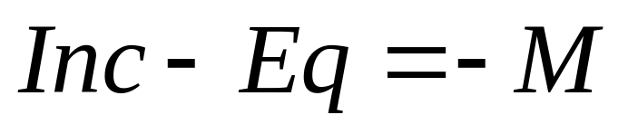
Nature of a system : Hypostatic
What happend if I remove a join ?
Static - Energetic - CAUC- 2011

Slide 18
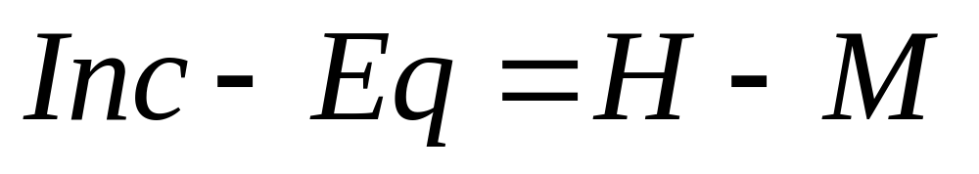
Nature of a system
Static - Energetic - CAUC- 2011

Slide 19
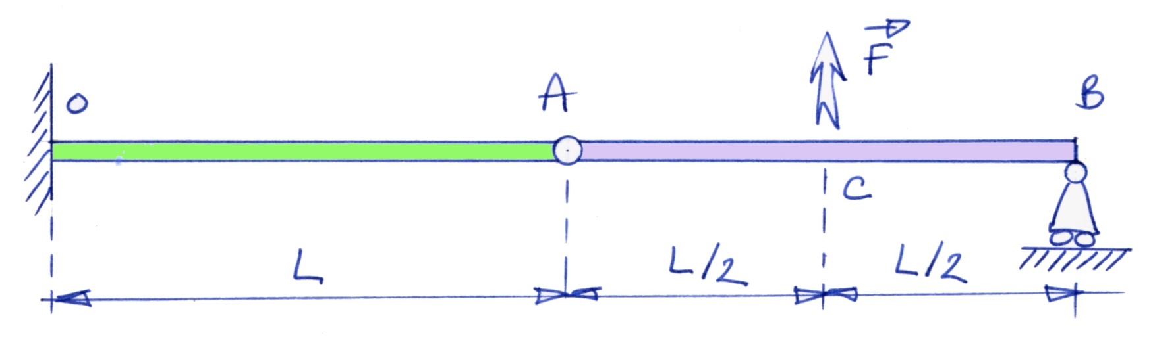
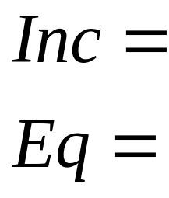
Isostatic System : Exemple
Static - Energetic - CAUC- 2011

Slide 20
Static : Important remark
All the equations that translate a state of equilibrium have been written in an intial position, before the loads have been applied
Static - Energetic - CAUC- 2011

Slide 21
2 - Energetic for structures
OBJECTIVES:
• Work of External Loads
• Stiffness and Compliance Matrix
• Maxwell Betti’s Theorem
• Castigliano’s Theorem
Static - Energetic - CAUC- 2011

Slide 22
Energetic for structures
Assumptions
• All the joins will be perfect,
• The load will be applied slowly,
• The behaviour of the structures will be a linear behaviour
The work of the external loads (forces and moments) will be transformed totaly in elastic energy inside the structure
Static - Energetic - CAUC- 2011

Slide 23
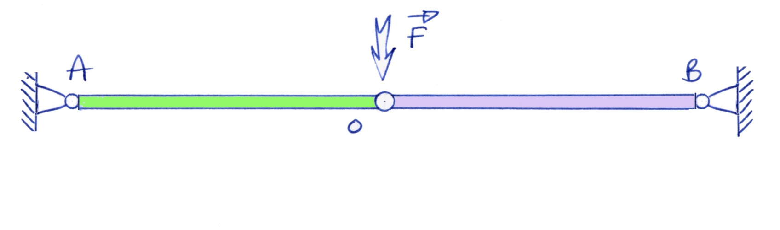
Exemple of non linear structure
Static - Energetic - CAUC- 2011

Slide 24
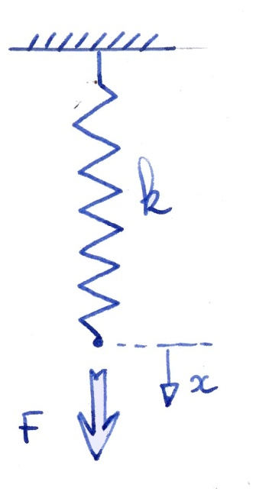
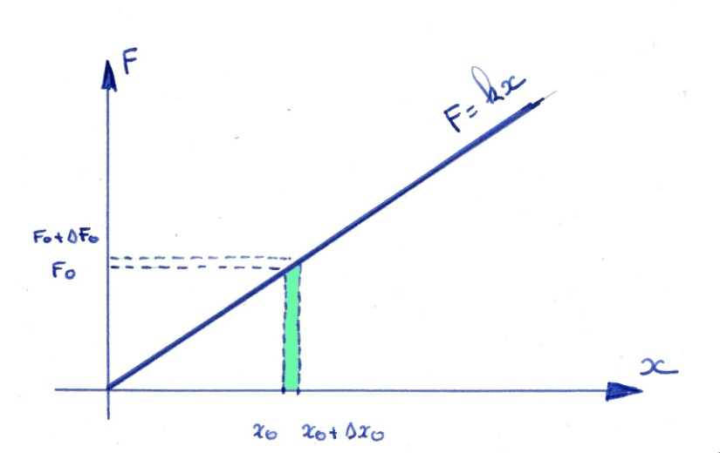

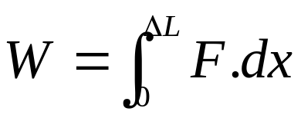
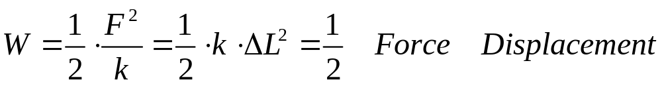
Internal energy in a spring
The Internal energy inside the spring is equal to the work of the external Load applied.
Static - Energetic - CAUC- 2011

Slide 25
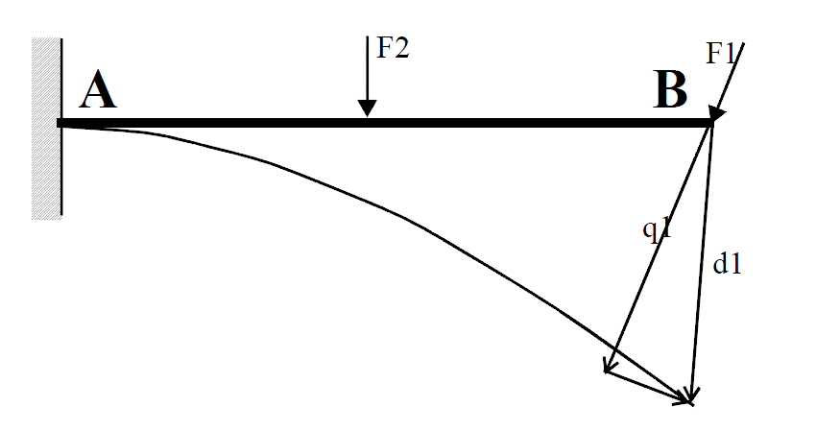
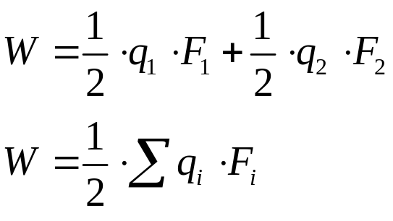
Internal Energy in a structure
d1 is the real displacement of the point B
q1 is the displacement of the point B, in the direction of the force F1
Static - Energetic - CAUC- 2011

Slide 26
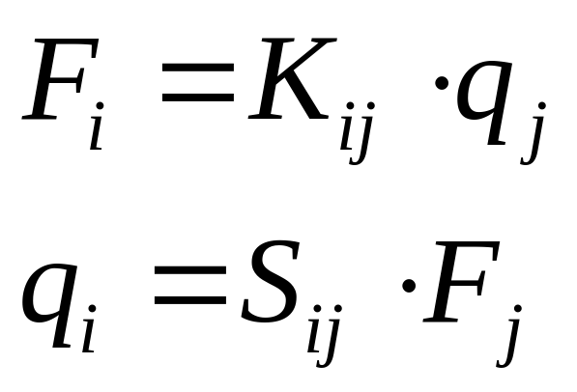
Internal Energy
The structures having a linear behavior, all the displacements are proportional to the external forces. The displacements are linear functions of efforts. The efforts are linear functions of displacements
Kij is the stiffness Matrix
Sij is the flexibility Matrix
Static - Energetic - CAUC- 2011

Slide 27
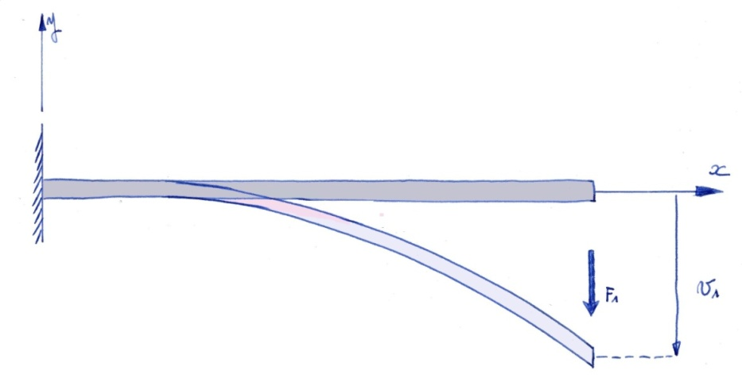

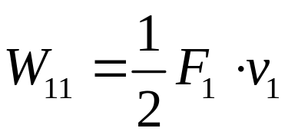
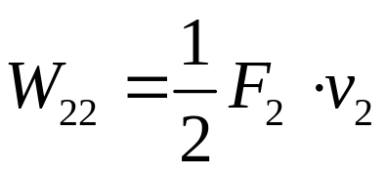
Maxwell Betti
Static - Energetic - CAUC- 2011

Slide 28
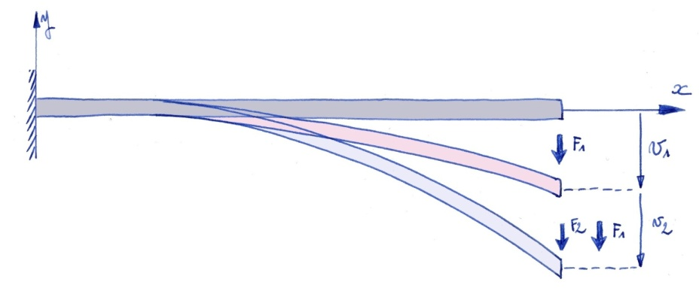
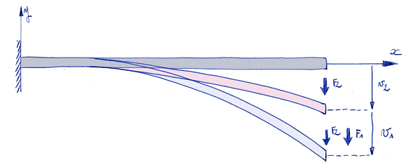
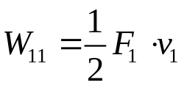


Maxwell Betti
Static - Energetic - CAUC- 2011

Slide 29
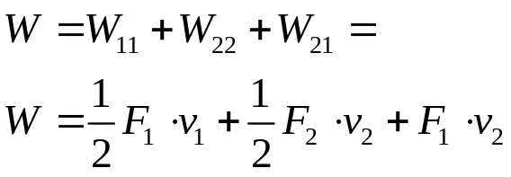
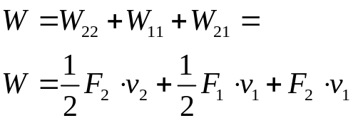
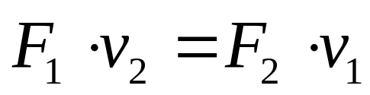
Maxwell Betti’s Theorem
For a structure with a linear behaviour :
The Work of a first set of forces applied to a structure, in the field of displacement generated by a second set of forces applied to the same structure
IS EQUAL TO
The Work of the second set of forces applied to a structure, in the field of displacement generated by the first set of forces applied to the same structure
Static - Energetic - CAUC- 2011

Slide 30
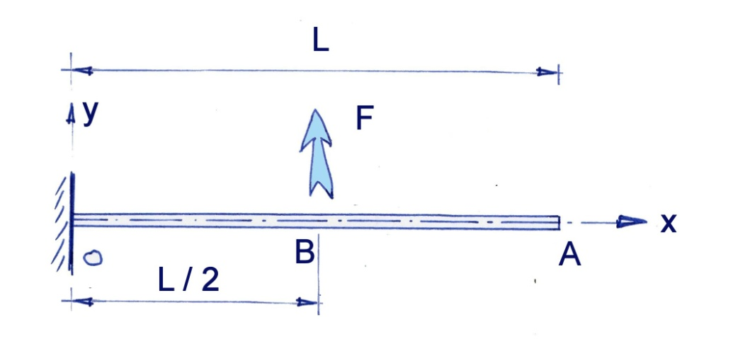
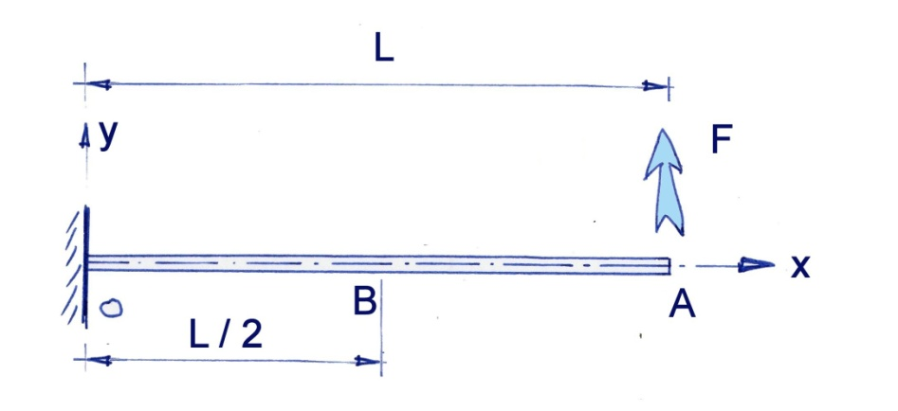
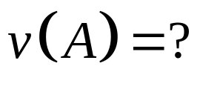
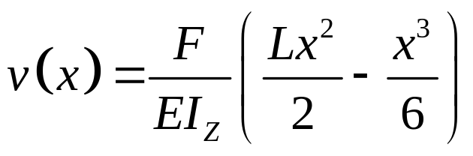
Maxwell Betti’s Theorem : Exemple
Static - Energetic - CAUC- 2011

Slide 31
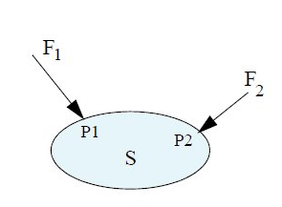
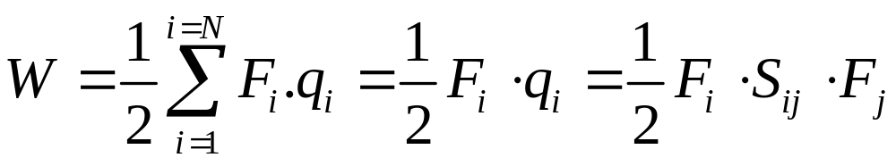
Stiffness matrix / Flexibility Matrix
Static - Energetic - CAUC- 2011

Slide 32
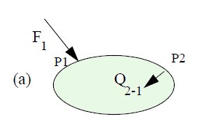
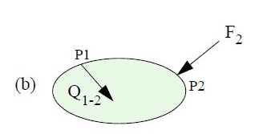
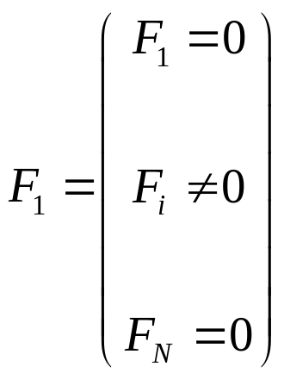
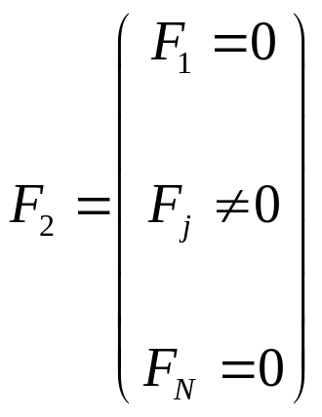
Stiffness matrix / Flexibility Matrix
Static - Energetic - CAUC- 2011

Slide 33
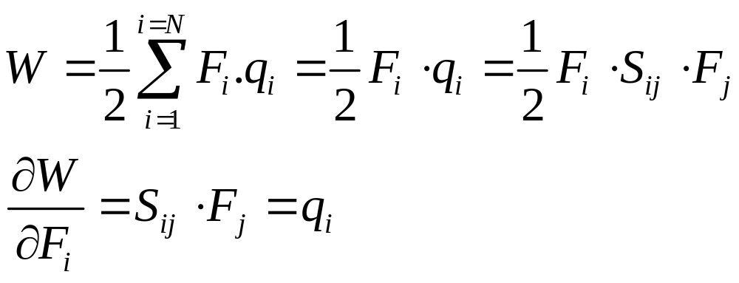
Castigliano’s Theorem
Remark : We can apply the Castigliano’s Theorem only if the structure has a linear behavior.
Static - Energetic - CAUC- 2011

Slide 34

Castigliano’s Theorem
Castigliano’s Theorem: If the elastic energy stored in a structure is expressed only in terms of the external forces, then the partial derivative of this energy with respect of one of these forces is equal to the displacement of the point of application of this force in the direction of this force.
Static - Energetic - CAUC- 2011

Slide 35

Castigliano’s Theorem : Exemple
Static - Energetic - CAUC- 2011

Slide 36
Castigliano’s Theorem : Remarks
Remark 1 : As we write the equilibrium of the structure in a non deformed state, we need a spring with a great stiffness
Remark 2 : If the stiffness of the spring is small the linear theory is no long efficient
Static - Energetic - CAUC- 2011

Slide 37

Virtual Force’s Theorem
If you wish to search for the displacement at a point where there is no force applied, you can created a virtual force in this point, compute the internal energy, do the derivative of the internal energy with respect of this virtual force, and give to the virtual force a value very near of zero.
Static - Energetic - CAUC- 2011

Slide 38

Virtual Force’s Theorem : Exemple
Static - Energetic - CAUC- 2011

